Slide 1
1.WHAT IS A STARTUP?

Slide 2
-Startups are a special kind of businesses that are based on an inovative idea. -startUPS are usually related to the IT field and mostly started by computer science enthusiasts.

Slide 3
Facebook, Microsoft, Google, Apple, amazon were once startups and all of them were started by programmers.

Slide 4
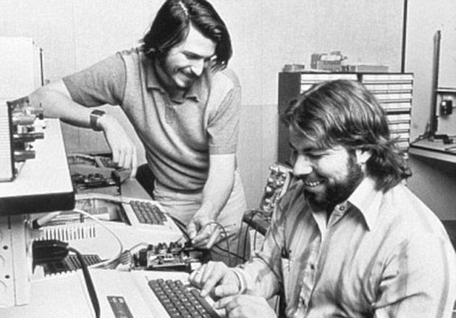


Slide 5
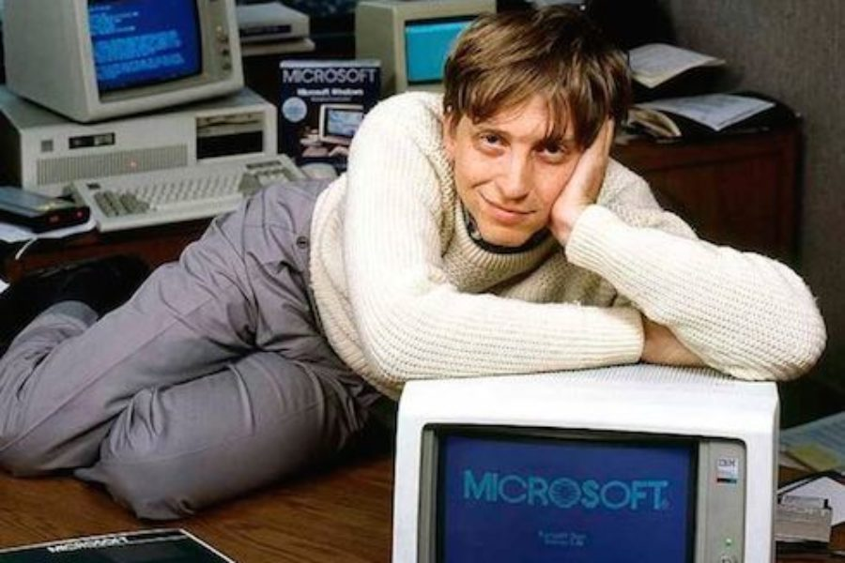


Slide 6
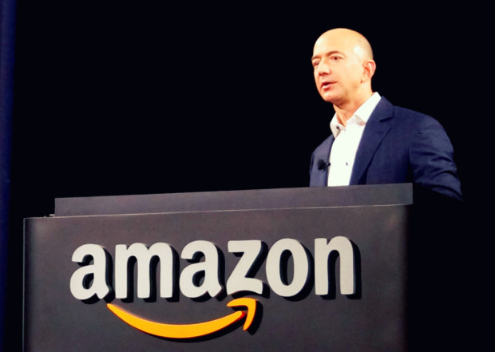

Slide 7
These guys weren’t geniuses in computer science. They Just had great ideas that they wanted to pursue.

Slide 8
WARNING! Start-ups face high uncertainty and do have high rates of failure, but the minority that go on to be successful companies have the potential to become large and influential. ABOUT 70% fail

Slide 9
What do you need to build a startup? Initially, you need a really good idea that adresses a problem in a inovational way.

Slide 10
VALIDATE YOUR IDEA BEFORE YOU START BUILDING ANY PROTOTYPE, YOU SHOULD TEST THE MARKET. loTS OF STARTUPS FAIL BECAUSE THE FOUNDERS HAD NO IDEA WHAT THE CLIENTS WANT OR HOW TO MAKE THEM BELIEVE IN THEIR IDEA.

Slide 11
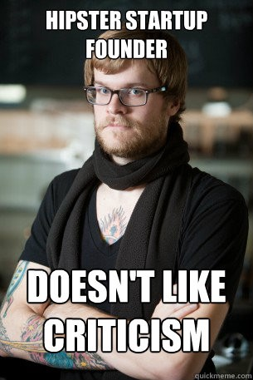
accept CRITICISM!

Slide 12
You’re not alone! There’s a good chance that other people also tought about the same idea as yours! You have to check the market for any other similar products so you won’t waste your time beliving you hit the jackpot. If there really isn’t anything like yours, you should think about building It.

Slide 13
Build YOUR TEAM Another key thing in having a successful startup is having a great team. Don’t try to make it all by yourself. find the best people you can work with and that really believe in what you want to build. It’s better to have a smaller slice from bigger pie. (or not having a pie at all)

Slide 14
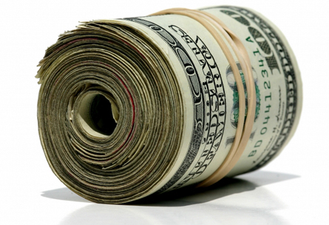
Money
You will obviously need money to build your business. Here comes you ability to convince other that your idea and product is great.
Without external funding you have almost no chance in surviving

Slide 15
How do you obtain funding? Not like this…

Slide 16
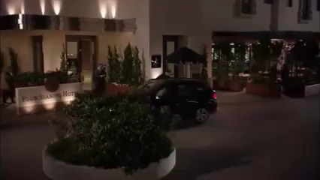

Slide 17
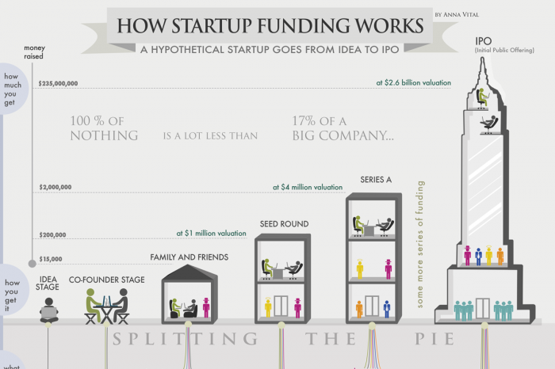

Slide 18

Startup failure
can't raise enough initial angel/VC funding
wasting too much money at early stages
company doesn't begin with the best people
doesn't produce something people want
hires too many people too quickly
hires the wrong people, or people with the wrong skills
doesn't produce a working product in a timely manner
not able to successfully monetize the idea
beaten out by a competitor

Slide 19
Today’s quite difficult to begin a startup but you should consider it if you really think you have a good idea. Maybe you don’t have that great idea. No problem! These come in time and with experience. Thus, make connections, meet people, Share your toughts! You never know when you hit the jackpot

Slide 20
Thank you. Questions?

